Slide 1
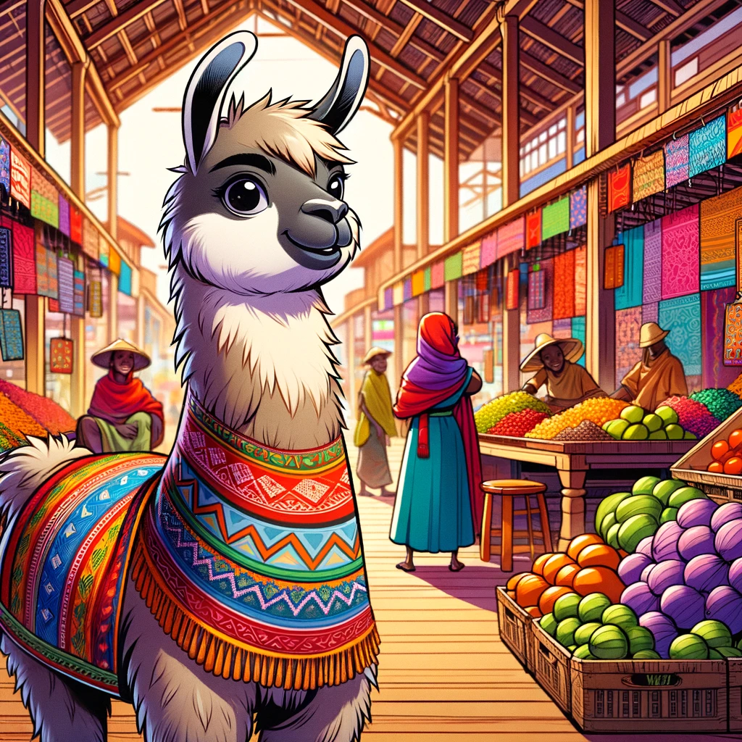
Swahili - LLM
Dr Michael Mollel (PhD)
Link to the project: GitHub
Link to the model: HF

Slide 2
Politics Part of LLM
DPO, KTO, RLHF etc all are complex things
Things to talk
Building the Bridge
Swahili LLM
What and Why
Empowering local content
End

Slide 3
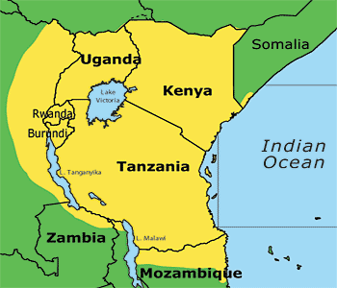
Bridging Language Gaps in AI
Large Language Models (LLMs) like ChatGPT have revolutionized natural language processing (NLP) capabilities
However, these models often struggle with low-resource languages and lack customization options
Swahili, a widely spoken language in East and Southern Africa, has limited language support in current LLMs
Swahili is spoken by more than 150 million people throughout the yellow-highlighted region
Source: https://www.safaricrewtanzania.com/en/language-kiswahili/

Slide 4
Swahili-LLM
Swahili –LLMs are the Large Language Model (LLM) that addresses the Swahili-speaking population's unique linguistic characteristics and needs.
The main objectives and features of Swahili-LLM include:
Linguistic Inclusivity: Bridging the gap in AI technology by providing a powerful tool for language processing and generation in Swahili, a language spoken by millions but often underrepresented in the digital and AI landscapes.
Open-Source Model: Unlike closed-source Large Language Models, which are restricted in access and customization, Swahili-Llama would ideally be open-source. This allows for greater flexibility, enabling developers, researchers, and users to tailor the model to their needs and contribute to its ongoing improvement.
Versatile Application Support: The model supports various applications, from text generation and sentiment analysis to supervised fine-tuning to different applications.
Customization and Localization: To offer an open-source solution that allows for extensive customization and localization, enabling developers, businesses, and governmental organizations to tailor AI applications to suit specific needs and cultural contexts of Swahili-speaking populations.

Slide 5
Swahili-LLM: Why Swahili LLM
Customization at Scale: Explicitly tailored for Swahili, it allows for fine-tuning to meet the unique needs of various applications, from text generation to sentiment analysis.
Open-Source Accessibility: Enables developers in low-resource settings to innovate and develop AI solutions that are genuinely relevant to their communities.
Bridging Language Gaps: By providing a robust tool for Swahili, Swahili-LLM paves the way for greater inclusivity in AI, ensuring that technology serves everyone, irrespective of their primary language.
The Impact: Swahili-LLM is not just a technological breakthrough; it's a step towards democratizing AI, making it accessible and useful for millions of Swahili speakers. It represents a significant leap towards closing the digital divide, fostering local content creation, enhancing educational tools, and improving access to information.

Slide 6
Please share your slides and codes
Email Dr Mollel : msamwelmollel@gmail.com
Davis: davisdavid179@gmail.com
Prosperity: prosperitypaulking@gmail.com

Slide 7
Empowering Local Content and Businesses
Swahili-LLM stands at the forefront of a transformative journey, breaking new ground by localizing AI technology for millions of Swahili speakers. Its development is pivotal in making advanced AI tools accessible and relevant to the East and Southern African communities.
Key Use Cases:
Small Business Support: Swahili-LLM enables small businesses to leverage AI to enhance customer service, conduct market analysis, and create local content that resonates with their target audience.
Education: By providing educational content in Swahili, the model can help overcome language barriers in learning, making education more inclusive and accessible.
Public Services: Government and public service applications can use Swahili-LLM to develop sophisticated applications that ensure security and efficiency since it is open source.

Slide 8
Empowering Local Content and Businesses
Driving Innovation and Inclusivity:
Technological Advancement: Swahili-LLM's sophisticated understanding of Swahili demonstrates a significant leap in AI, particularly in handling the language's nuances more efficiently than ever.
Community Empowerment: This model empowers communities by enhancing digital literacy, fostering local content creation, and enabling a more inclusive digital economy.
The Vision: Our vision with Swahili-LLM is to create a tool and ignite a movement towards more linguistically inclusive technologies. We aim to inspire innovation that respects and uplifts local cultures and languages, making technology a true enabler of progress for all.

Slide 9
Technical Part of LLM
Prompting and RAG are equivalent to feature engineering (data augmentation, to be exact) in the traditional ML paradigm while finetuning and pretraining are equivalent to model training. So, all three are needed for the best results.
Andriy Burkov
TalentNeuron
Procedure for creating your LLMs
Vocabulary Expansion
Continue the Pretraining Foundation Model
Finetuning for Instruction Following
Finetuning for Model Alignment
Low-Rank Adaptation (LoRA)
Advance Finetuning

Slide 10
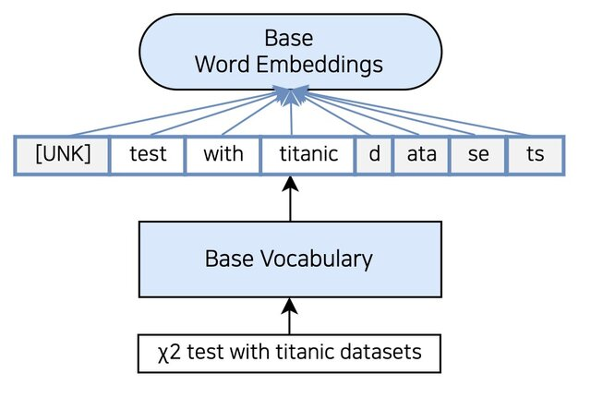
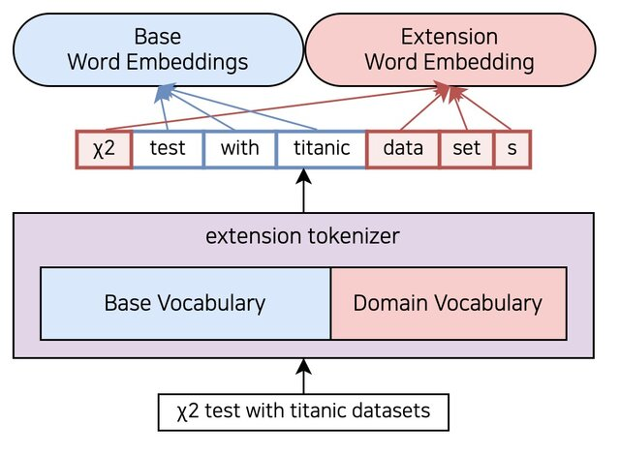
Vocabulary Expansion
Get your text corpus (Dataset approx. more than 1B words)
Train dataset with tokenizer model (LLaMA 2, LLaMA3, Gemma – Sentence Piece Model) link.
Merge the trained tokenizer with the original Foundation model tokenizer by taking the union of vocabularies
Resize LLM's word embeddings and language model head for the new merged vocabulary size
Swahili
Test with Swahili datasets
Swahili
Test with Swahili datasets

Slide 11
Vocabulary Expansion
Get your text corpus (Dataset approx. more than 1B words)
Train dataset with tokenizer model (LLaMA 2, LLaMA3, Gemma – Sentence Piece Model) link.
Merge the trained tokenizer with the original Foundation model tokenizer by taking the union of vocabularies
Resize LLM’s word embeddings and language model head for the new merged vocabulary size
Resized Word Embeddings
Swahili
Test with Swahili datasets

Slide 12
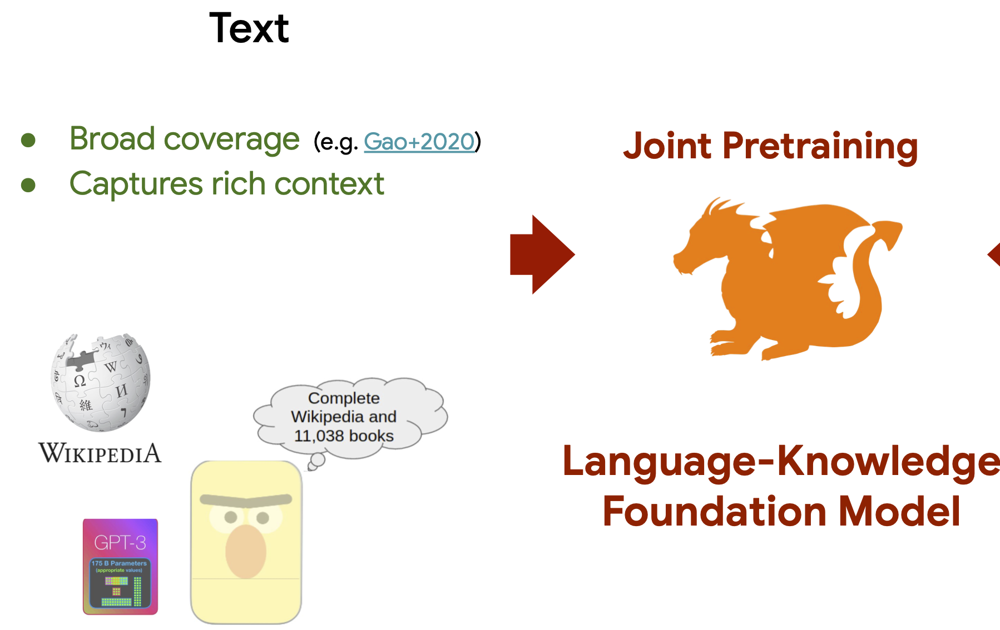
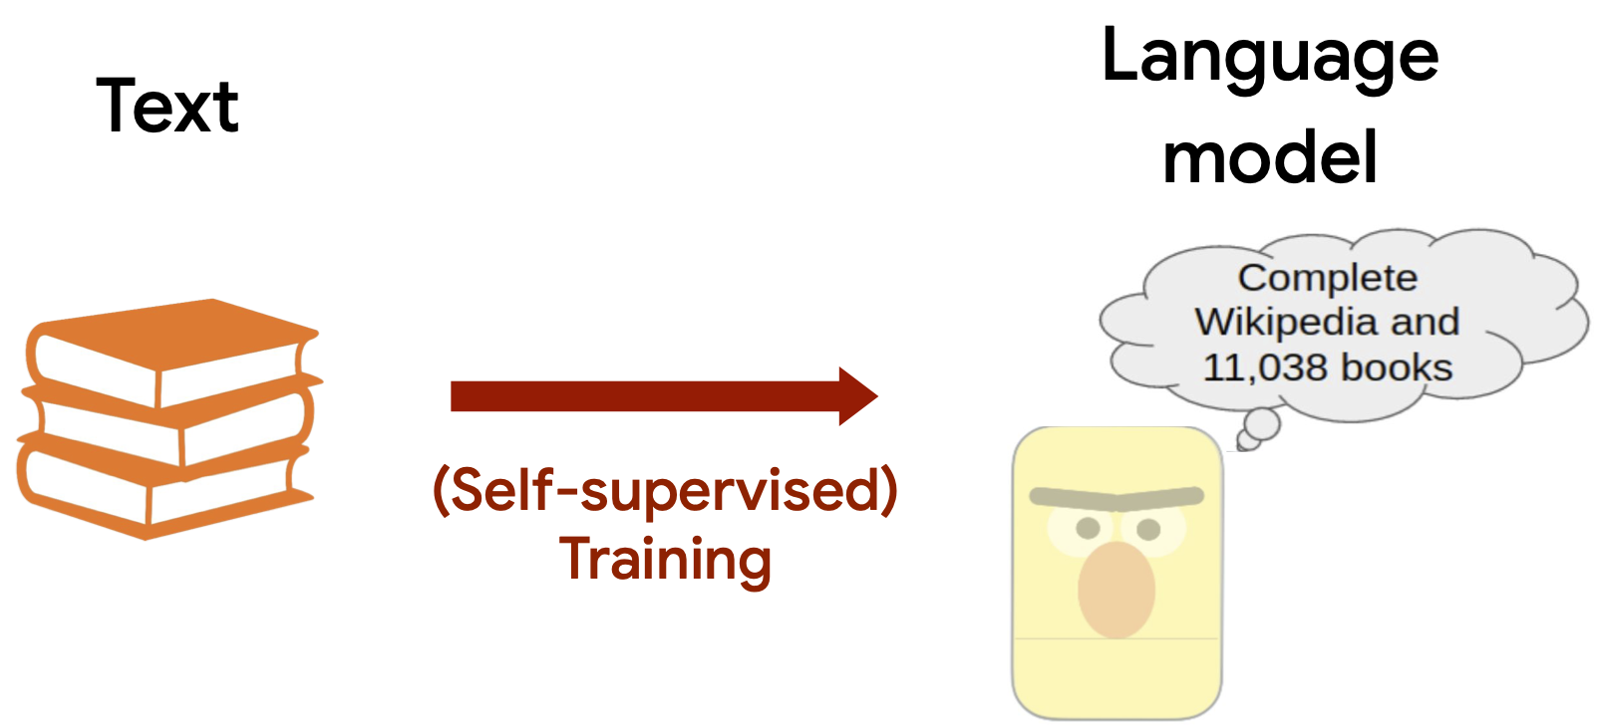

Continue the Pretraining Foundation Model
Initialize model with original Foundation model weights
Pretrain on Dataset corpus using Causal Language Modeling (CLM) as an objective
Apply Low-Rank Adaptation (LoRA) for efficient

Slide 13
Finetuning for Instruction Following
Collect instruction-following data
Use prompt template:
c) Finetune LLM on instruction data with supervised learning
d) Calculate loss only on the {Majibu} part of the sequence
e) Apply LoRA for efficient finetuning
### Maelezo:
{Majibu}
### Majibu:
{Majibu}

Slide 14
Technique Finetuning
Collect instruction-following data
Use prompt template:
c) Finetune LLM on instruction data with supervised learning
d) Calculate loss only on the {Majibu} part of the sequence
e) Apply LoRA for efficient finetuning
### Maelezo:
{Majibu}
### Majibu:
{Majibu}

Slide 15
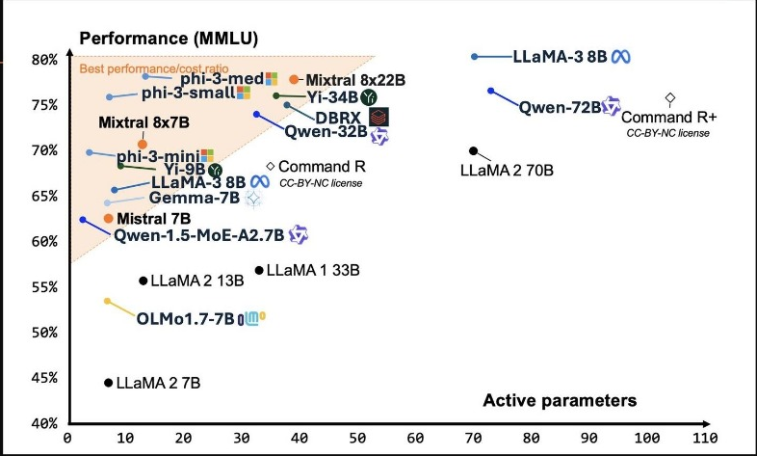
What are the best Foundation Model

Slide 16
Current Swahili Benchmark
Naïve Implementation (Unofficial)
S/N | Model Name | Average | ARC-C (300) | ARC-E | MMLU | HellaSwag | winogrande
1 | Swahili –LLaMA-2 (7B) | <33% | <33%
2 | LLaMA-2 (7B) | <33% | <33%
3 | Kiswallama (7B) | <33% | <33%
4 | Ulizallama (7B) | <33% | <33%
5 | Swahili-Gemma (7B) | 39% | 39%
6 | Gemma (7B) | 35% | 35%
7 | Swahili-Alpaca-LLaMA3
8 | Swahili-LLaMA3
9 | LLaMA3
10 | Swahili-Alpaca-Phi3
11 | Swahili-Phi3
12 | Phi3

Slide 17
Hackathon
Examples
Rag starter:
https://www.kaggle.com/code/mikemollel/rag-gemma-swahili2.
SfT data creation example:
https://www.kaggle.com/code/mikemollel/swahili-gemma-dataset-creation3.
Evaluate Swahili LLM ARC Challange Task: https://www.kaggle.com/code/mikemollel/evaluator-swahili-llms

